Slide 1
2
1
50
1
50
1
3
11
21
3
10
14
0
20
10
11
3
17
3
2
4
0
1
20
36
10
17
11
21
2
4

Slide 2
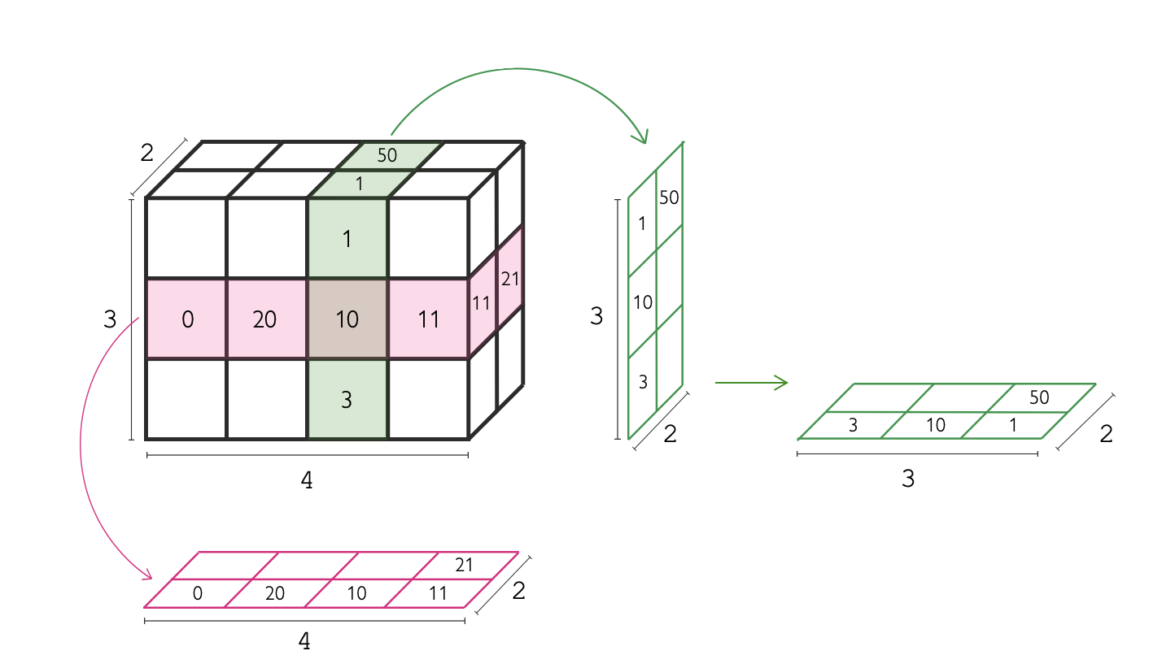
2D image
5D image
Pixel
Y
Y
Y
v
X
Y
Z
3D image
X
Y
Voxel
Y
Z
Y
X
Z
Time
Z
X
Z
X
X
X
Slicing a multidimensional image
Channels
Pixels and voxels can be isotropic or anisotropic
Isotropic pixels
Anisotropic pixels

Slide 3
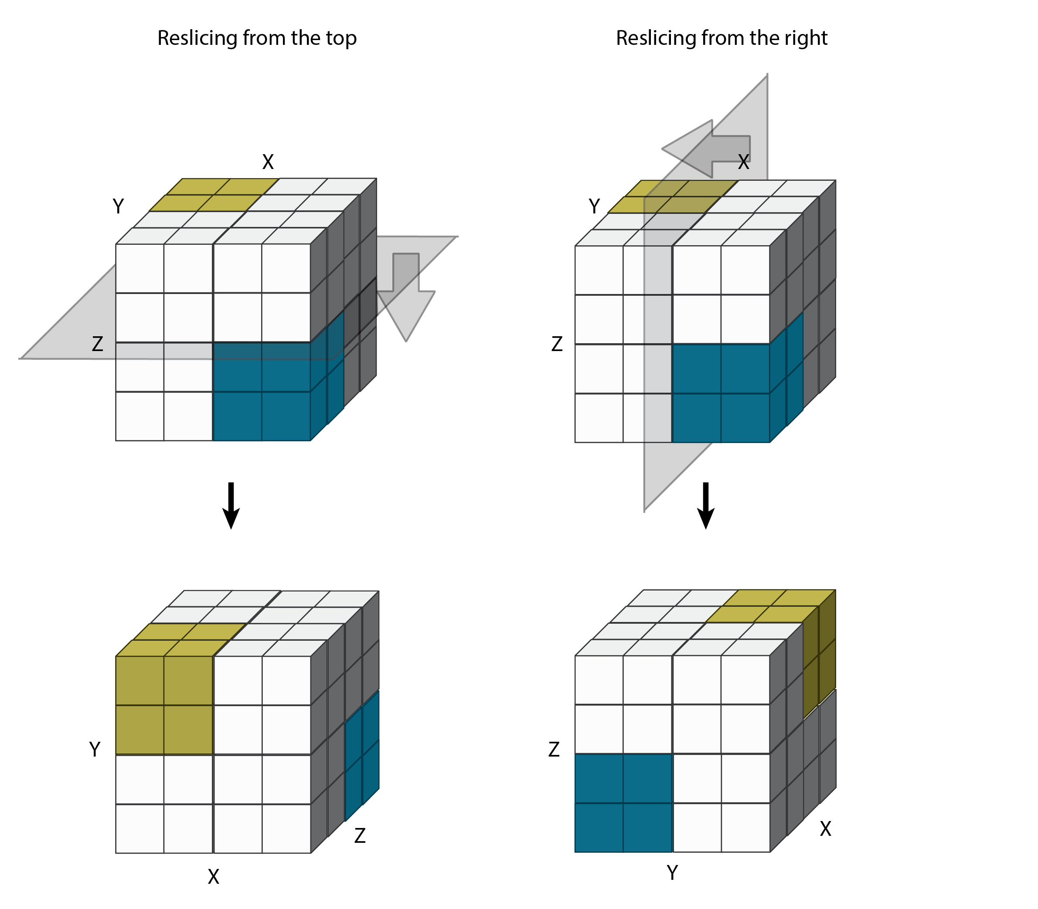
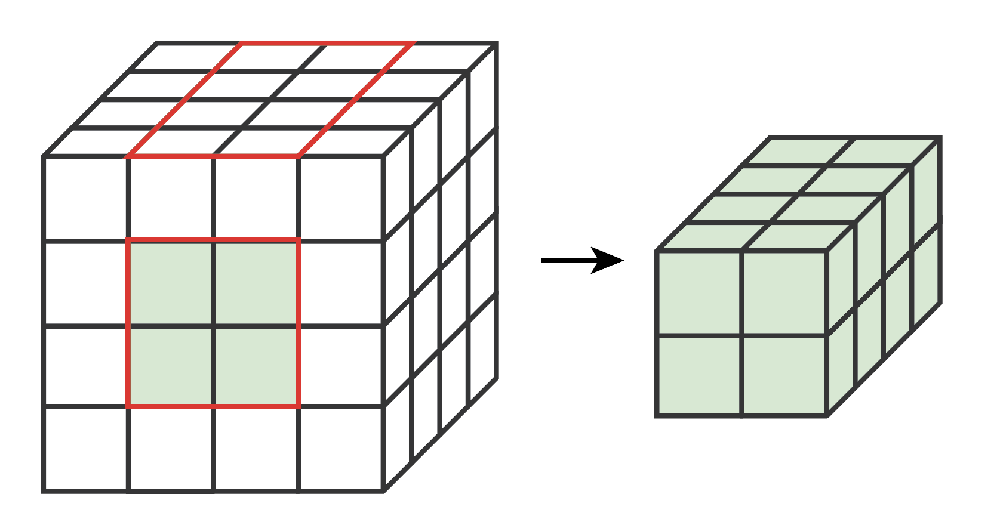
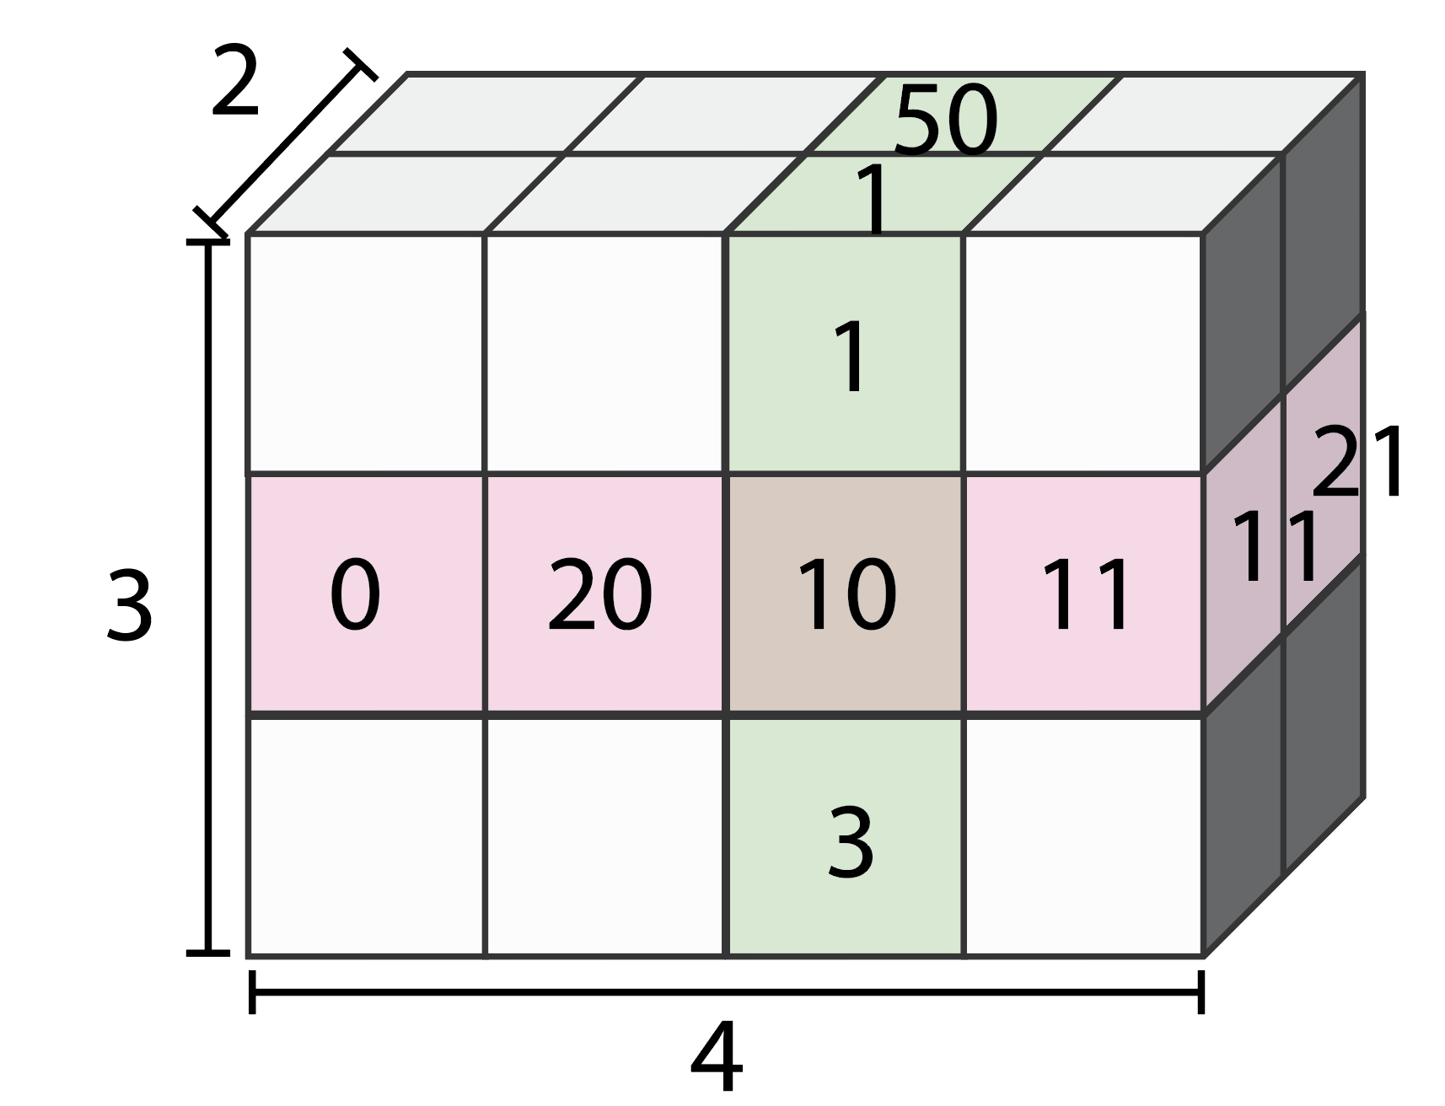
Rotating dimensions (reslicing)
(N-D image to N-D image)
Subsetting
(3D image to smaller 3D image)
Slicing
(3D image to 2D slice)

